Slide 1
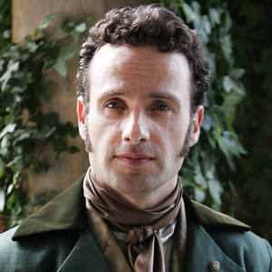
Edgar Linton
Jealousy

Slide 2
Quotation
“I wish I had light hair and fair skin, and was dressed and behaved as well,and had a chance of being as rich as he will be” (Bronte 59)

Slide 3
Justification
This quote shows Heathcliff’s jealousy of Edgar of his appearance and status. He wants to be able to provide Catherine with the power and social class that Edgar provides. This later sets the series for his plan to take the Linton’s money and destroy Edgar and Catherine’s marriage.

Slide 4
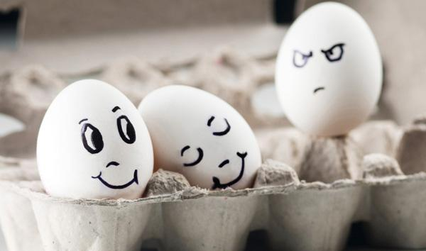
Art form

Slide 5
Art justification
The egg on the far right represents Heathcliff and the expression on it’s face shows his jealousy of Catherine and Edgar’s relationship. The other two eggs represent Edgar and Catherine who fell in love after Catherine is injured and forced to stay with the Linton’s.

Slide 6
Works Cited
Bronte, Emily. Wuthering Heights. New York. Penguin books. 2009. Print

