Slide 1
Sold by Patricia McCormick
Independent novel NGO assignment

Slide 2
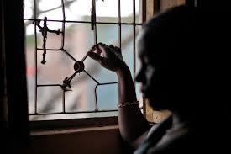
Quote #1
"The Lassi has made my brain too hazy to keep track of how many men have been here. I do not know how much they pay. All I know is that each time one leaves, my debt to Mumtaz grows a little smaller" (MCCormick 130)

Slide 3
Effect
The effects of the drugs are messing with Lakshmi brain which shows the manipulative effect that the Brothels use to control the girls. It also weakens her spirit to fight back against Mumtaz.

Slide 4
Quote #2
"How can they eat and laugh and carry on as normal when soon the men will come is so perplexing that while they laugh, I fight back tears"(MCCormick 137)

Slide 5
Effect
this shows the normality the other girls have adopted to becoming Prostitutes while showing the psychological toll it is having on Lakshmi which could develop into depression in later life because people in her community view prostitutes and runaways as subhumans as shown earlier in the novel.

Slide 6
Name of NGO
Prerana

Slide 7
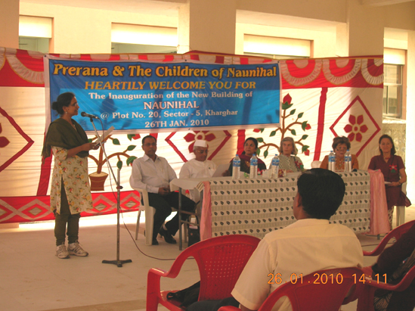
Programs
-three night care center for at-risk children.
-residential training center for girls victims of Human Trafficking.
-Shelter homes.

Slide 8
How they can help
Prerana works in the Red-light district in Mumbai India. They would help because that is where Lakshmi most likely is as the story says that she crosses the border into India and Mumbai is the biggest city. Lakshmi could have moved into one of Prerana's multiple night shelters and rehabilitate back into her life.

Slide 9
Link
http://www.preranaantitrafficking.org/programs/nightcare.htm

